Slide 1
SC||Skill Circle

Slide 2
Movie sentiment
Leveraging Machine Learning for
Movie Sentiment Prediction
Presented by : Ravi Kumar

Slide 3
Introduction
Movie reviews play an important role in influencing audience decisions and reflecting public opinion. With the growth of online platforms such as IMDb, Rotten Tomatoes, and social media, vast amounts of user-generated reviews are available. However, manually analyzing these reviews is time-consuming and inefficient.
Sentiment analysis using Machine Learning (ML) provides an automated way to classify movie reviews as positive, negative, or neutral. By leveraging Natural Language Processing (NLP) techniques and ML algorithms such as Naïve Bayes, Logistic Regression, Support Vector Machines, or deep learning models like LSTMs and Transformers, we can extract meaningful patterns from text data.
This approach helps in understanding audience preferences, improving recommendation systems, and assisting production houses or streaming platforms in decision-making. Ultimately, movie sentiment analysis combines the power of data, language, and machine learning to provide deeper insights into viewer opinions.

Slide 4
Why Movie Sentiment Domain?
Movies are one of the most popular forms of entertainment, attracting millions of viewers worldwide.
Online platforms like IMDb, Rotten Tomatoes, and social media generate huge volumes of reviews daily.
Sentiment analysis in this domain helps understand audience opinions, predict movie success, and guide production houses and streaming platforms.
It supports recommendation systems by suggesting movies based on viewer sentiment patterns.
The domain is rich in data, making it an excellent use case for applying and testing various machine learning and NLP models.

Slide 5
Project’s Significance and its Benefits to Movie Sentiment
Helps in understanding the audience’s perception of movies by analyzing large volumes of reviews automatically.
Provides valuable insights for production houses, streaming platforms, and distributors to evaluate success and improve future projects.
Assists in building personalized movie recommendation systems, enhancing user experience on platforms like Netflix, Amazon Prime, etc.
Enables early detection of trends and preferences, which supports decision-making in marketing and content creation.
Demonstrates the real-world application of Machine Learning and NLP in handling unstructured text data effectively.

Slide 6
Exploratory Data Analysis (EDA)
Understanding the distribution of reviews (positive, negative, neutral).
Checking for data imbalance between sentiment classes.
Visualizing word frequency using word clouds or bar charts.
Identifying most common positive and negative keywords.
Cleaning text (removing stop words, punctuation, and duplicates) for preprocessing.

Slide 7
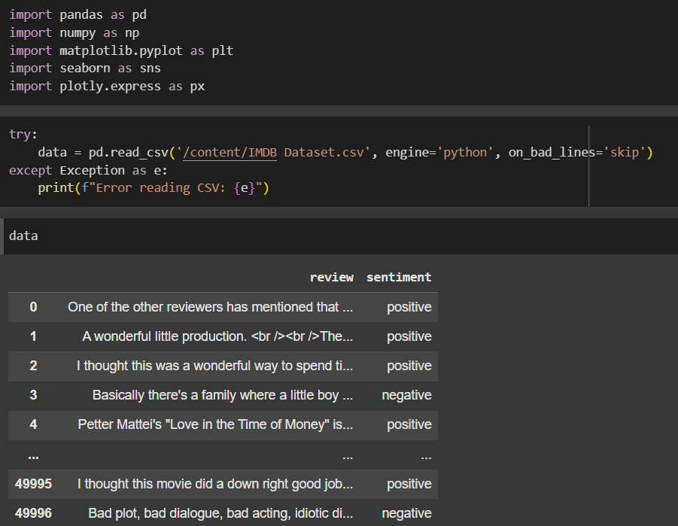
The code imports libraries, then loads the IMDB dataset containing movie reviews and their sentiments (positive/negative).
This is the first step in Exploratory Data Analysis (EDA) for movie sentiment classification.

Slide 8
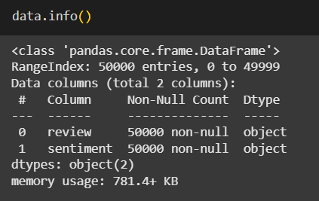
The Data Frame has 50000 rows, indexed has 0 to 49999.
There are 2 Columns.

Slide 9
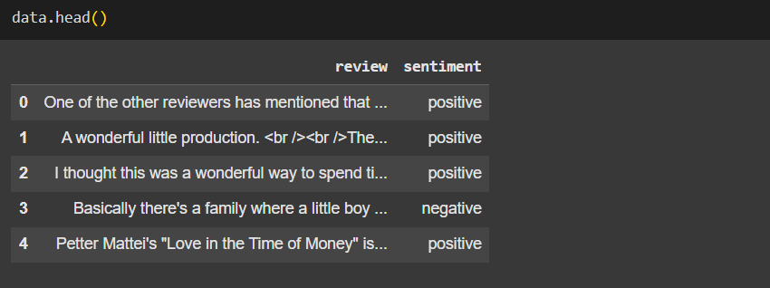
The Data Set show 5 rows.

Slide 10
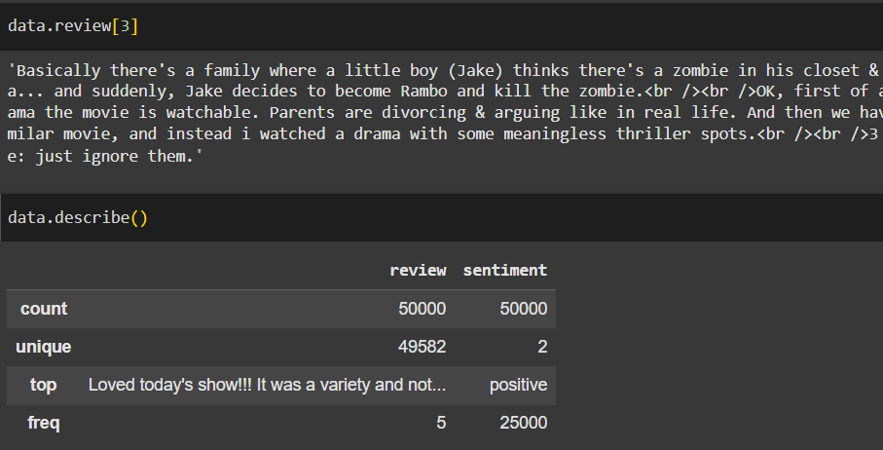
The command data.review[3] displays the 4th review text from the dataset.
data.describe() summarizes the columns: 50,000 reviews and sentiments in total.
There are 49,582 unique reviews, and only 2 unique sentiments.
The most common sentiment is positive (25,000 times), showing balanced classes.

Slide 11
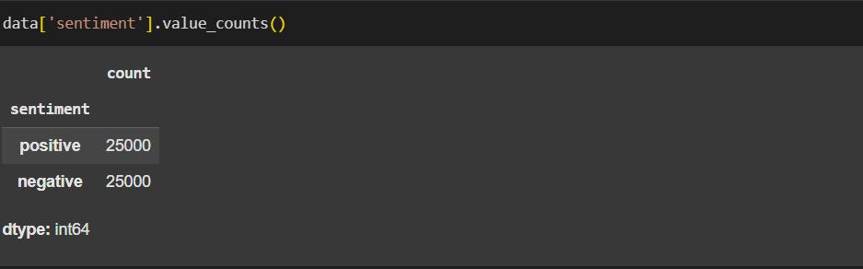
The command data['sentiment'].value_counts() counts the frequency of each sentiment.
There are 25,000 positive reviews and 25,000 negative reviews.
This shows the dataset is perfectly balanced between both classes.
Such balance is ideal for training machine learning models without bias.

Slide 12
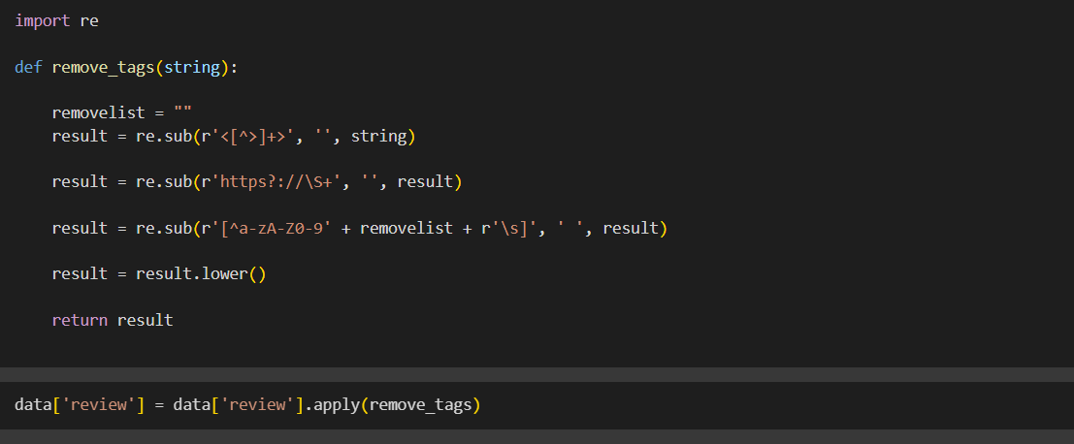
The code defines a function remove_tags() to clean the review text.
It removes HTML tags, URLs, and any special characters/numbers, keeping only words.
The text is then converted to lowercase for uniformity.
Finally, .apply(remove_tags) is used to clean all reviews in the dataset.

Slide 13
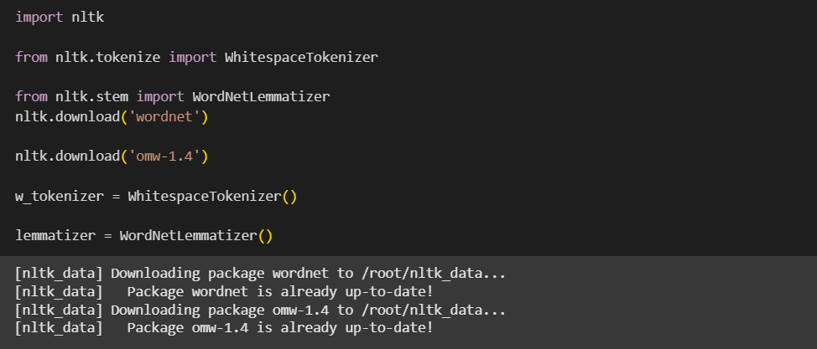
The code imports NLTK and downloads the required resources: wordnet and omw-1.4.
It uses WhitespaceTokenizer() to split text into tokens based on spaces.
WordNetLemmatizer() is initialized to reduce words to their base form.
This prepares the dataset for text normalization before applying machine learning models.

Slide 14
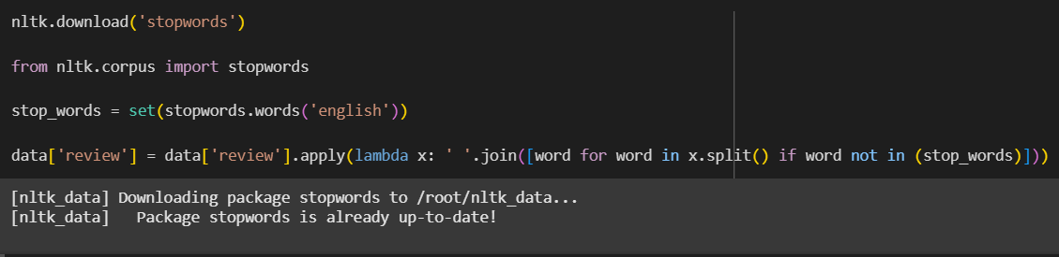
Stopwords were removed from the text data using NLTK to reduce noise and improve clarity.
Common words like the, is, and were filtered out as they add little semantic value.
This preprocessing step enhances the efficiency of NLP models by focusing on meaningful terms.
As a result, the cleaned dataset is more suitable for tasks like sentiment analysis and classification.

Slide 15
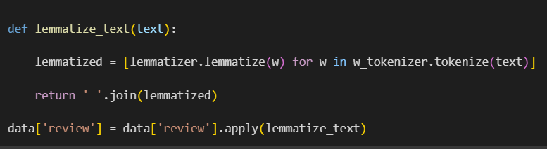
Lemmatization was applied to reduce words to their base or dictionary form. This ensures that different inflections of A word are treated as the same feature. It improves text normalization and helps reduce vocabulary size.

Slide 16
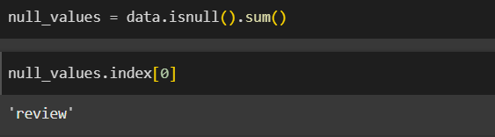
There is no null values in data set.

Slide 17
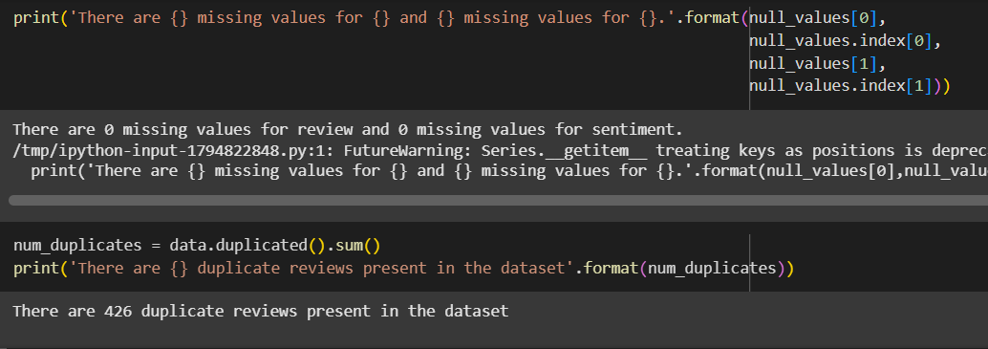
Data validation was performed to check for missing values in the dataset.
No missing values were found in either the review or sentiment columns.
Duplicate records were identified to ensure data quality and consistency.
A total of 426 duplicate reviews were detected in the dataset.

Slide 18
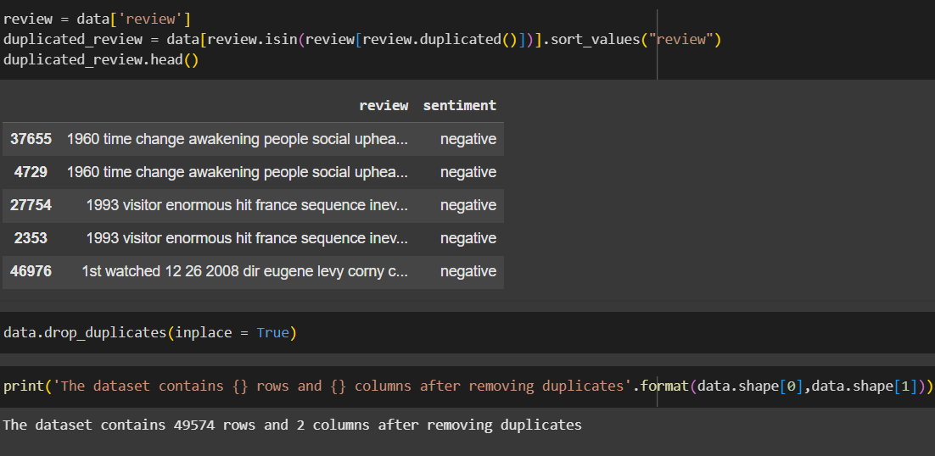
Duplicate reviews in the dataset were identified using the duplicated() function.
A sample of duplicate records was displayed to verify the issue.
Duplicate entries can bias the model by over-representing certain reviews.
To ensure data quality, all duplicate rows were removed using drop_duplicates().
After removing duplicates, the dataset was reduced to 49,574 rows and 2 columns.
This preprocessing step ensures that each review contributes uniquely to the analysis.

Slide 19
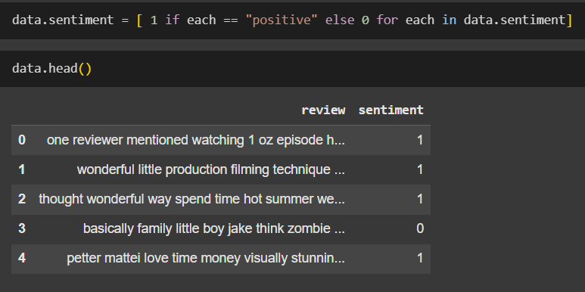
Sentiment labels were converted into binary numeric values for model compatibility.
Positive reviews were encoded as 1, while negative reviews were encoded as 0.
This transformation simplifies the classification task for machine learning algorithms.
The dataset now contains cleaned text reviews along with binary sentiment labels.

Slide 20
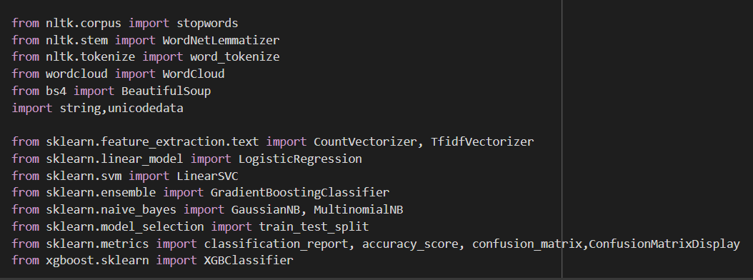
The code Import libraries.

Slide 21
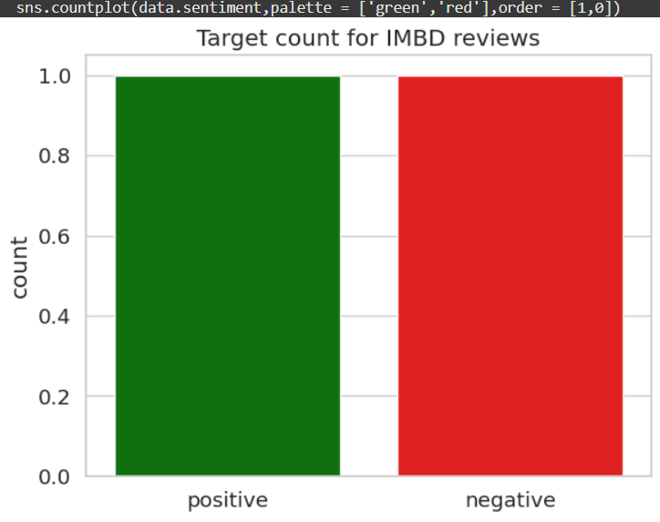
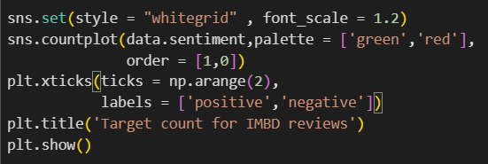
A countplot was generated to visualize the distribution of positive and negative sentiments.
Reviews were represented in green for positive and red for negative classes.
This helped in identifying whether the dataset was balanced or skewed.
Visualization ensures better understanding of target class distribution before model training.

Slide 22
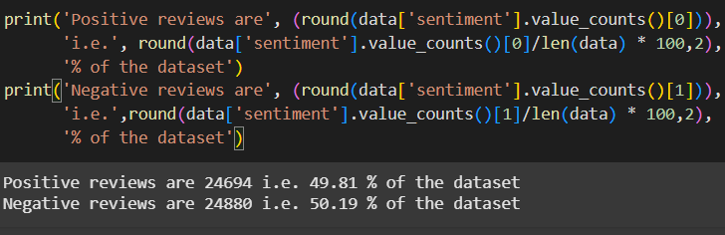
Sentiment distribution analysis was conducted to check class balance in the dataset.
The dataset contains 24,694 positive reviews (49.81%) and 24,880 negative reviews (50.19%).
The nearly equal distribution indicates a well-balanced dataset.
A balanced dataset helps in training unbiased machine learning models for sentiment classification.

Slide 23
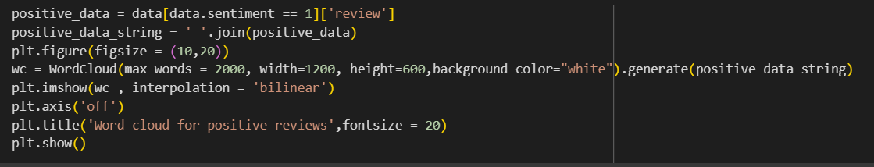
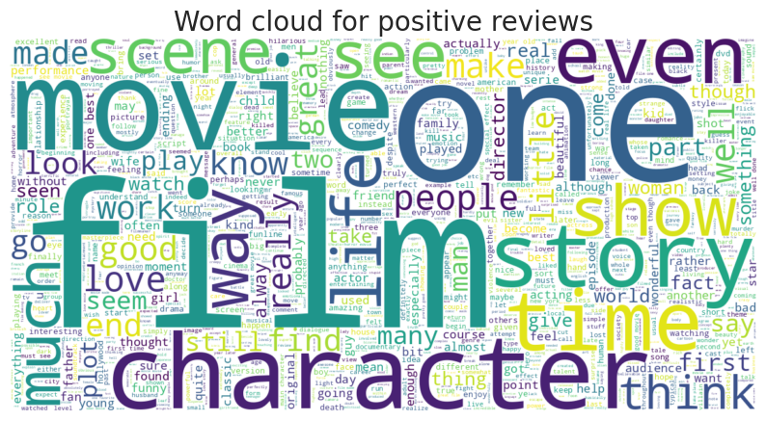
Word cloud for positive reviews

Slide 24
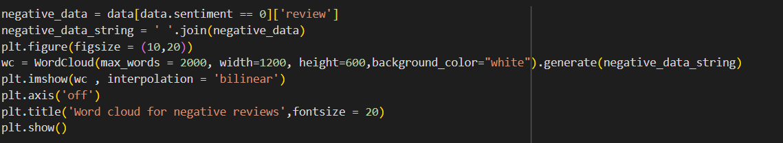
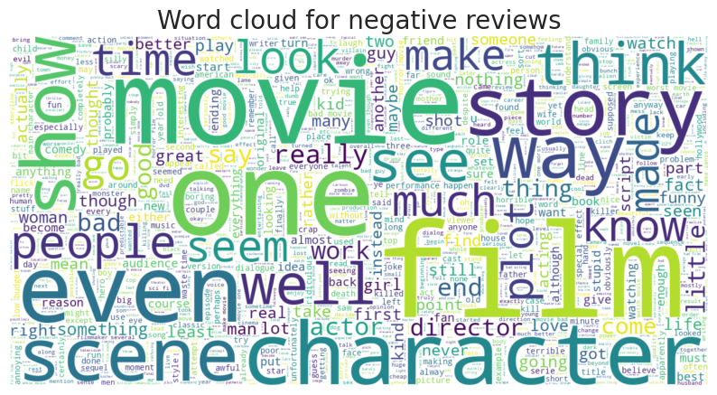
Word cloud for negative reviews

Slide 25
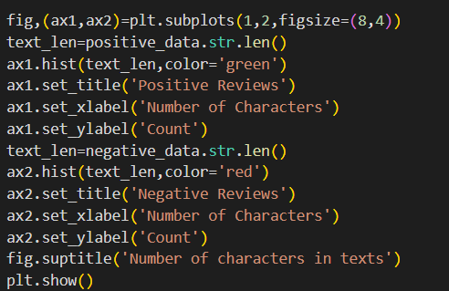
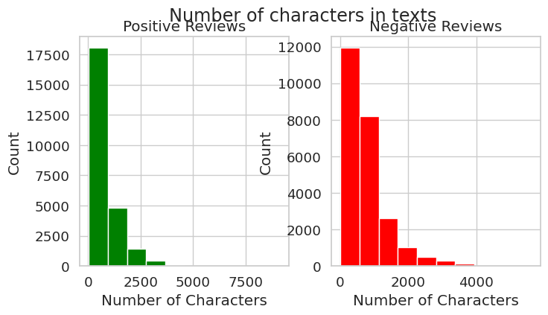
To analyze text length distribution, histograms of character counts were plotted for positive and negative reviews.
Positive reviews were shown in green, while negative reviews were shown in red for clear visualization.
The analysis highlights the variation in review lengths across sentiments.
This step helps in understanding the dataset and in selecting preprocessing techniques like padding or truncation for modeling.

Slide 26
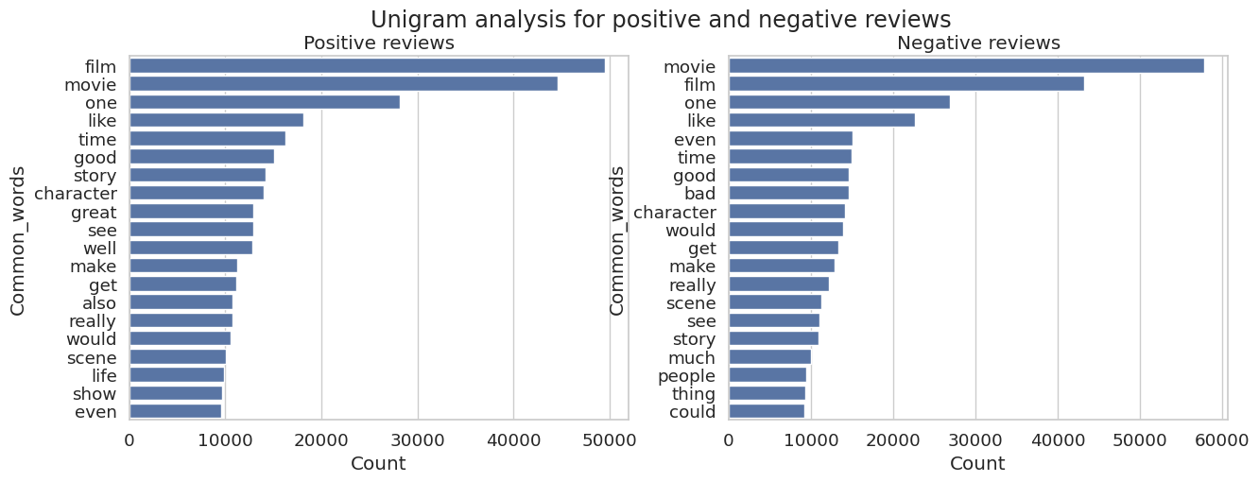
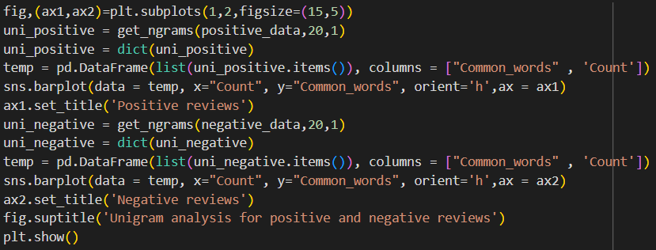
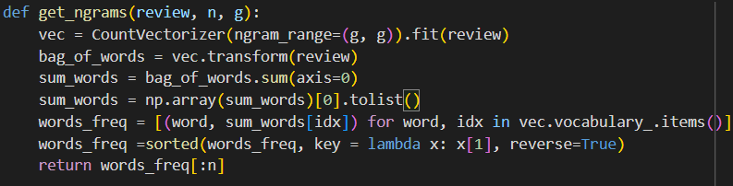
Unigram analysis for positive and negative reviews

Slide 27
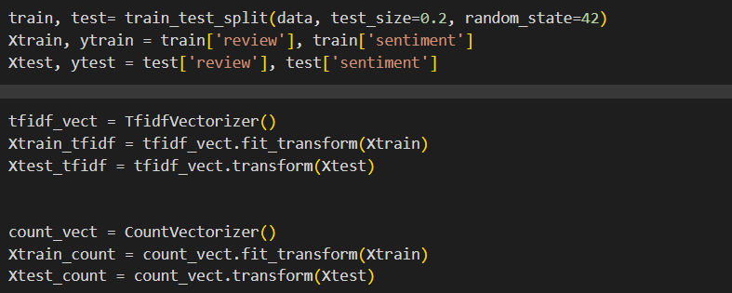
The dataset was divided into training (80%) and testing (20%) sets to evaluate model performance.
Text preprocessing was performed using TF-IDF Vectorization to capture word importance.
Count Vectorization was also applied to represent text data as word frequency vectors.
Both feature extraction methods were used to compare their impact on sentiment classification accuracy.

Slide 28
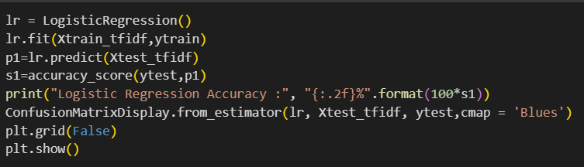
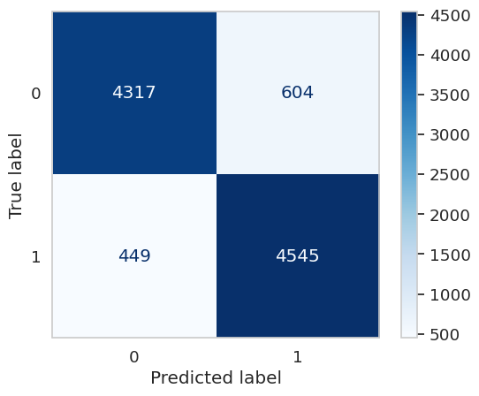
Line 1: Model creation and training.
Line 2: Accuracy computation and printing.
Line 3: Confusion matrix visualization.
Line 4: Display the plot.
Accuracy ≈ 88.62%
Precision ≈ 88.27%
Recall ≈ 91.01%
F1 Score ≈ 89.62%

Slide 29
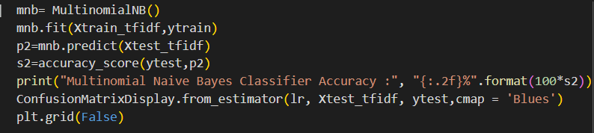
Corrected the confusion matrix line (you had lr instead of mnb).
Removed .grid(False) — optional and can be skipped in minimal code.

Slide 30
Confusion matrix
Accuracy = 88.62%
Precision = 88.27%
Recall = 91.01%
F1 Score = 89.62%

Slide 31
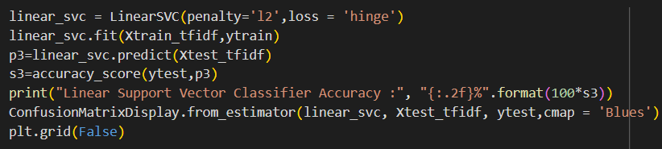
This project implements a text classification model using a Linear Support Vector Classifier (SVC). TF-IDF is used to convert raw text into numerical features. The model is trained on labeled data and evaluated on test data for accuracy. A confusion matrix is displayed to visualize classification performance.

Slide 32

Confusion matrix
The classifier achieved an accuracy of approximately 89.1%,
with a precision of 89.0%,
recall of 91.0%, and
F1-score of 90.0%.

Slide 33
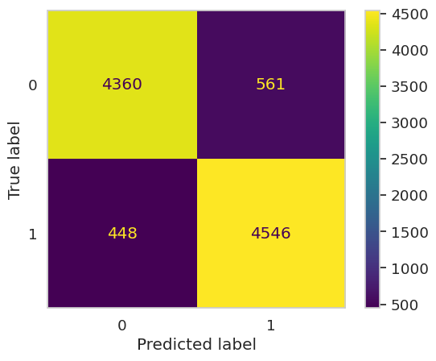
Confusion matrix
The XGBoost classifier was trained using TF-IDF features and achieved an accuracy of approximately 85.27%. The confusion matrix shows the model's performance across true vs. predicted labels.

Slide 34
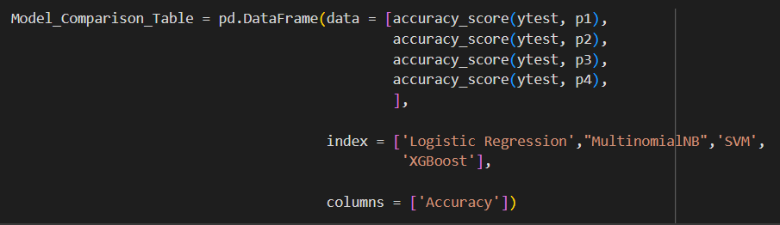
Model comparison

Slide 35
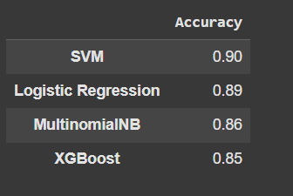
Model accuracy comparison
Model | Accuracy
SVM | 0.90
Logistic Regression | 0.89
MultinomialNB | 0.86
XGBoost | 0.85

Slide 36
conclusion
In this project, we analyzed movie reviews to determine their sentiment as positive or negative. After experimenting with several machine learning models, the Support Vector Machine (SVM) outperformed others with an accuracy of 90%, followed by Logistic Regression, Multinomial Naive Bayes, and XGBoost. The results demonstrate that linear models like SVM are highly effective for text classification tasks such as sentiment analysis, especially when combined with TF-IDF feature extraction. This model can be used to assist in understanding audience opinions at scale and improve recommendation systems.

